Slide 1
Successnet Reports
What is mastery?

Slide 2
Test Scores report
Notes:
Click Reports, and choose Test Scores to see the test results for your class.

Slide 3
Test Scores: Single Test mastery
Notes:
When you click on the test date, these are the test details you will see:

Slide 4
Test Questions and Responses
Notes:
When you click on a student name, you see the test questions and how the student answered:

Slide 5
Mastery report
Notes:
The Mastery tab will show you a report of mastery by textbook skill or state core standard.

Slide 6
Mastery report (and Test Scores report) student details (click on student name):
Notes:
When you click on a student name, you see a detailed student report for all tests

Slide 7
Prescription
(Unit 2 Volume 1 page 270a; Differentiated Instruction page 53; Unit 3 Volume 2 Interactive Review pages 10-15;)
DI – Differentiated Instruction pages;
IR = Interactive Review pages;
RWN = Reader’s & Writer’s Notebook pages
Notes:
Prescription example:

Slide 8
View Results
Notes:
When you click on “view results”, you see the student test result summary

Slide 9
Mastery report: Skill key
Notes:
Skill mastery key from Mastery report:

Slide 10
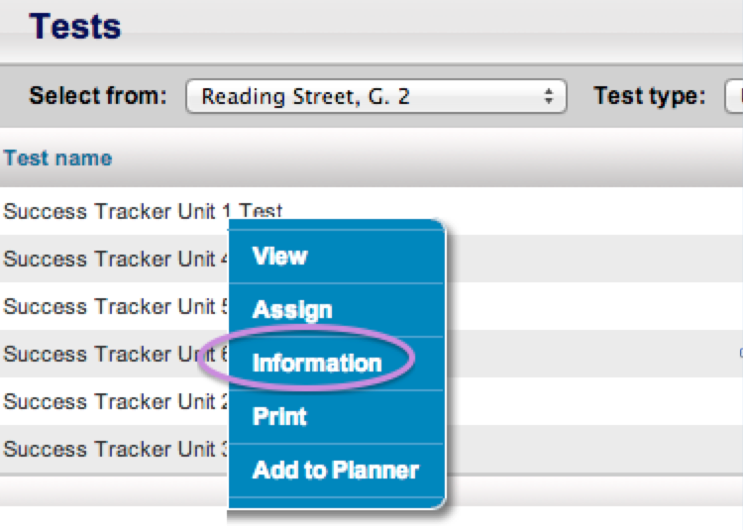
Understanding Mastery in SuccessNet
Our district “Mastery” level is set at 80%, meaning that for a student to demonstrate mastery on a skill, they must earn 80% of the total points possible for that skill.
Each test item is related to a specific skill and is weighted specifically. To view that info, click on Content, then Tests, then choose a test and click on its Test Name. When you do that, you will see a drop-down menu. From that menu, choose “Information”.
Notes:
When you click on Information, you will see something similar to the following (see graphic on next slide):

Slide 11
Test information
Notes:
The Test Score report can show you how a student demonstrated mastery on that SINGLE test (when you click on a test date). The Mastery report is a cumulative (ALL tests taken) view of student mastery. It is NOT a simple average of student test scores on that skill; rather, mastery is determined by a summation (total) of all points accrued on the test items representing that skill.
Test 1
For example, let’s say at the beginning of the year, Amber takes Unit 1 Weekly Test 1 and earns 1 of a possible 2 points for “Author’s Purpose”. We know from the test information that at least 1.6 points (80%) were required for a student to meet mastery. SuccessNet reports would show that Amber has not demonstrated mastery of that skill.

Slide 12
Test 2
If a teacher looks at Amber’s mastery on that SINGLE test (by going to the Test Score report and clicking on the test date), she will see that Amber did NOT meet mastery on that single test and skill.
If the teacher looks at a Mastery report, she will see that Amber did NOT meet mastery based on all tests taken so far for that skill.
(test 1: 1 out of 2 points, test 2: 1 out of 2 points; total points earned = 2, total points possible = 4;
total points required for mastery based on these two tests = 3.2 [1.6 + 1.6]).
Notes:
Then Amber takes Unit 1 Weekly Test 3 and again earns 1 of a possible 2 points for “Author’s Purpose”. We know from the test information that at least 1.6 points were required to demonstrate mastery of that skill on that test.

Slide 13
Test 3
If a teacher looks at Amber’s mastery on that SINGLE test (by going to the Test Score report and clicking on the test date), she will see that Amber DID meet mastery on that single test and skill.
If the teacher looks at a Mastery report, she will see that Amber did NOT meet mastery based on all tests taken so far for that skill.
(test 1: 1 out of 2 points, test 2: 1 out of 2 points, test 3: 4 out of 4 points; total points earned = 6, total points possible = 8;
total points required for mastery based on these two tests = 6.4 [1.6 + 1.6 + 3.2]).
Notes:
Then Amber doesn’t take another test online until the Unit test. On the Unit 1 test she earns 4 out of the 4 possible points for “Author’s Purpose”. We know from the test information that at least 3.2 points (80%) were required to demonstrate mastery of that skill on that test.

Slide 14
Test 4
She would then show mastery on that skill for that single test. She would also now show that she DID demonstrate mastery on her Mastery report for all test items related to “Author’s Purpose” that she has been assessed on thus far.
(test 1: 1 out of 2 points, test 2: 1 out of 2 points, test 3: 4 out of 4 points, test 4: 2 out of 2 points; total points earned = 8, total points possible = 10;
total points required for mastery based on these two tests = 8.0 [1.6 + 1.6 + 3.2 + 1.6]).
ETC.
Notes:
Let’s now say Amber takes Unit 2 Weekly Test 4, where she is again tested on “Author’s Purpose” and she earns 2 of the 2 possible points for that skill.

Slide 15
Item Analysis report
Notes:
The Item Analysis report will tell you how your students answered each individual question on a specific test.
This report can be interesting to analyze how a single student performed on that test (orange oval). A teacher can then consider which skills that student is missing and make a plan for reteaching. This report also supports data analysis of incorrect answers that are commonly chosen by several students (purple oval). A teacher can they consider what the common misconception is and reteach/clarify that misconception with the class.

Slide 16
Item analysis
Notes:
For example, in the test data above, we see that several students selected “D” rather than the correct answer of “B” on Question 3. The teacher can click on a student name to see what Question 3 looks like. In this case:
Many students thought that, as a result of the blizzard, Ichiro’s mother rescheduled the tea party. But in the passage, it is clear that the tea party was not rescheduled; Eliza and Junko could not come to the tea party and Ichiro’s mother ended up having a tea party with her brothers, instead. Later in the week, Eliza and Junko came over to visit and they played in the snow and drank hot chocolate in their snow fort.
This is a 5th grade test, so a teacher may analyze this test item and note that her 5th graders’ comprehension skills wee lacking on this passage. The teacher could then consider reasons for the miscomprehension, possibly her students were not reading carefully, perhaps some struggled to read the grade level text, perhaps some students were not reading and rereading for detail. This is an opportunity to review and reteach – the teacher could review the passage and Question 3 with the class and discuss why B is correct. Perhaps 5th graders could self-identify why they missed that question, or perhaps the discussion is an opportunity to reinforce Close Reading and the importance of rereading text for details and comprehension.

